Slide 1
Computer Networks

Slide 2

Learning Outcomes
Describe the different types of Computer Networks
Explain what is meant by the WWW and the Internet
Explain what is meant by client server model
Explain what a communication protocol is and describe the different communication protocols
Describe the different hardware components necessary for internet use

Slide 3
Computer Networks
A computer network allows computers and devices to share data.
This includes:
Computer to computer communication
Computers communicating with devices such as printers, mice and keyboards
Mobile phone networks
Smart televisions
Devices downloading videos and music and playing them through external devices such a speakers and projectors.
There are different levels of networking. The next few slides outline some of them.

Slide 4
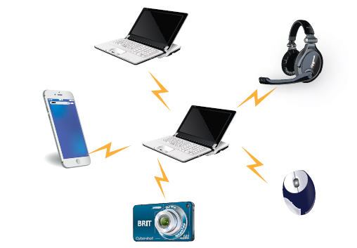
Personal Area Network (PAN)
A personal area network (PAN) is a network communicating up to 10 metres between computer devices such as laptops, mobile phones, tablets, media players, speakers and printers.
Bluetooth enabled devices can use PAN to connect to each other.
The PAN may just connect to the local devices or allow them to connect to higher level networks such as the internet.

Slide 5
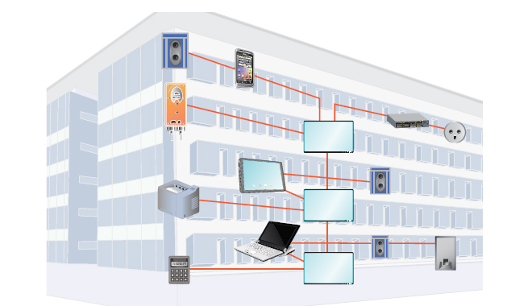
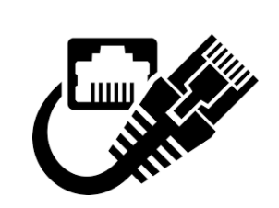
Local Area Network (LAN)
Computers in a site such as an office building use a local area network (LAN) to connect with each other.
A LAN is a computer network within a small geographical area such as a home, school, office or group of buildings on a local site.
Ethernet Cables can
connect devices in a LAN.

Slide 6
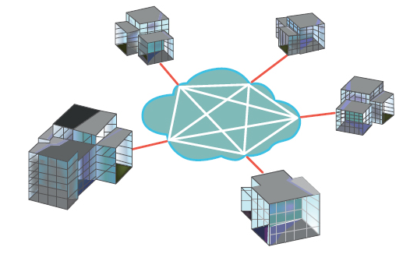
Wide Area Network (WAN)
A wide area network (WAN) is a network that connects separate LANs over a large geographical area.
This ensures that computers in one location can communicate with computers and users in other locations.
The internet is a huge wide area network.

Slide 7
Network Types
There are two network types: client server networks and peer to peer networks.
Peer to peer networks are used to connect a small number of devices, for example in a home or office with just a few users. They are cheaper to set up and maintain.
Client server networks are more expensive to set up and maintain as a more powerful computer is required to act as the server, network software is needed and specialist knowledge is needed to administer the network.

Slide 8
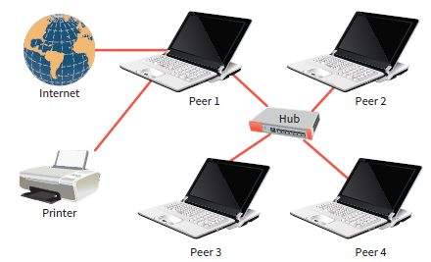
Peer to peer networks
In a peer to peer network, the computers are simply connected together without any one computer having any superiority over others.
Each computer acts as both a client and a server and can communicate directly with all of the others.
Data is stored on all of the computers and is not held centrally so each user is responsible for backing up procedures.
The users of each computer have to be able to grant access rights to its resources and allot passwords.

Slide 9
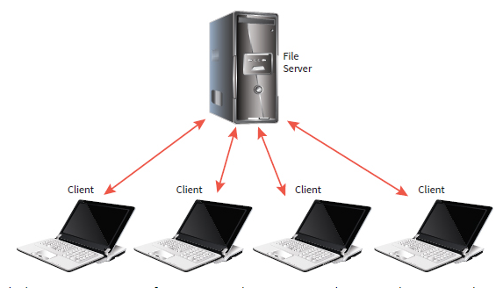
Client server networks
In a client server network there are two types of computers
The computers that control access to the network (servers)
The computers on which the users work (client)
From the client machines, the users log into the network in order to be able to access programs and peripherals and save data on the servers.
The server is responsible for the security of the network, expecting users to login with a username and password. All files are saved on the server.

Slide 10
Client Server model
In general, servers provide a resource or a service and clients request the resources or services.
The client server model is a simple distributed (shared) system i.e a system where the workload required to complete a task are shared between more than one computer. These computers are connected by some network over which messages are sent in order to complete the required tasks.
When there is a high demand for a services, i.e when many clients are making a request a the same time, servers may become overwhelmed. This happens when concert tickets are released and lots of people try to book them.
In a client server model there can be many clients and also many servers.

Slide 11
Network Topologies
A network’s topology is the organisation of the connections between the devices - how the network is laid out and how the devices should connect to one another.
There are two main topologies - Star and Mesh

Slide 12
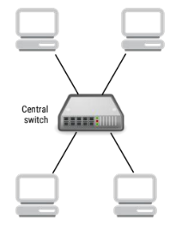
Star Topology
A network that adopts the star topology has devices that are indirectly connected via a central hub or switch.
The connections (lines) that come from the central switch to the devices form a shape that looks like a star.
NOTE: Star topology and client-server networks looks similar in diagrams. Devices arranged in a star topology connect via a central switch, but the applications that run could still adopt a peer-to-peer or a client-server model.

Slide 13
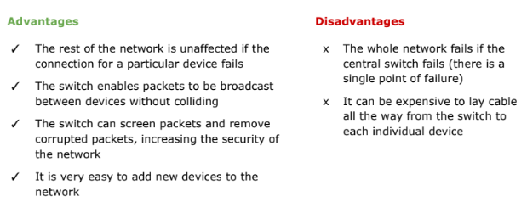
Advantages and disadvantages of of the star topology

Slide 14
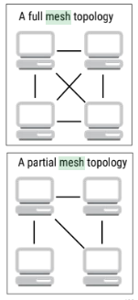
Mesh Topology
In a network based on the mesh topology, all devices are connected either directly or indirectly to each other without a central switch.
In a full mesh network, every device is directly connected to every other device.
In a partial mesh network, direct connections only exist between some devices.
NOTE: Mesh topology and peer-to-peer networks can look similar in diagrams.
A mesh network topology can support a client-server network where one of the devices is a server and the others are clients that connect to it either directly or indirectly.

Slide 15
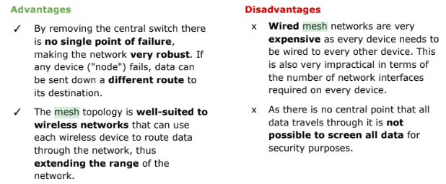
Advantages and disadvantages of mesh networks

Slide 16
The Internet and the World Wide Web

Slide 17
Terminology
The Internet and the World Wide Web (www) are two different things even though we tend to refer to them interchangeably.
The World Wide Web is a system (or network) of connected files hosted on the Internet.

Slide 18
The Internet
The Internet dates back to 1969 when two computers, one at UCLA in Los Angeles and one at SRI International in Menlo Park, California, communicated with each other.
Up until this time computers generally did not share data with each other. Data was moved between computers using large reels of magnetic tape.
The Internet is a global network of networks consisting of billions of connected computers and devices across the world.
Computers can include laptops, tablets and other devices but also smart devices such as TV’s, cars, security cameras, household appliances etc.
The computers are connected in different ways - copper wires, fibre optic lines, wireless satellite and microwave links and undersea cables.

Slide 19
The Internet
The Internet is a network of connected computers - the Internet is a network.
Internet of Things (IoT)
Computers are not just physical PC’s and laptops. They can be connected sensors, wearable devices, smart devices, TV’s, cars, household appliances etc. This is called the Internet of Things.
https://www.techtarget.com/iotagenda/definition/Internet-of-Things-IoT

Slide 20
The World Wide Web
The World Wide Web uses the Internet for transmission.
The Web was invented by Tim Berners-Lee in 1989. He created a way of putting websites onto the Internet.
All of these websites together are the World Wide Web.
The Web is a vast collection of documents (HTML, CSS, Javascript and other documents that represent webpages) with links to each other.
The web can also be used for email and instant messaging.

Slide 21
Client Server Model
When you visit a web page, your computer (client) issues a request that makes its way to the appropriate server.
A server is a computer that provides resources or services to other computers.
The server then carries out that request and the information representing the web page or other resource is transmitted to your computer.
Your browser renders it into what you see as a web page.
This is the most basic client server model - one client requests information from a server who provides the information.

Slide 22
Communication Protocols

Slide 23
Communication Protocols
A communication protocol is a set of rules describing how to transmit data across a network. The network can be the internet.
The client server model uses several different protocols, each governing communication in its own protocol “layer” of the network. Without these sets of rules, the client server model would not work.
The protocol layers and the names of their corresponding protocols are listed on the next slide.

Slide 24
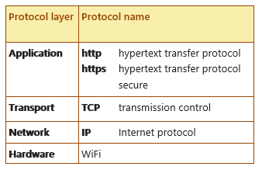
Communication Protocols

Slide 25
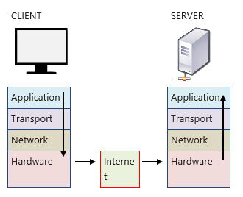
Communication Protocols (Higher Level)
The path taken by a client request, via the internet, to a particular server, can be illustrated like this.
The message travels down through the protocol layers in the client and then via the internet, passes up through the protocol layers in the server.
Rules from the relevant protocol are applied at each layer.

Slide 26
http and https
http stands for hypertext transfer protocol. You often see this at the beginning of a web address.
It operates at the application (program) layer.
http is known as a request-response protocol. It allows a client to issue a request for e.g. a webpage and the server to respond to the right computer with the data or resource required.
http is protocol specific to applications (programs) for example, the client’s web browser and the program that the server is running to host its web pages.
https (hypertext transfer protocol secure) is a secure version of http. When using https, data transmitted between client and server is automatically encrypted. Https has become the standard on the web in recent years, particularly for online payments.

Slide 27
TCP (Higher Level)
TCP stands for transmission control protocol.
The TCP protocol operates at the transport layer, ensuring that binary information is transported reliably between computers.
This information is broken up into “packets” for efficient routing. TCP keeps track of each of these packets, ensuring that they remain free of error and arrive at the client in the same order as those transmitted by the server.

Slide 28
IP (Higher Level)
IP stands for Internet Protocol. It operates at the network layer. This protocol handles the creation of the data packets and how they are routed around the network to their destination. It does this using IP addresses.
An IP (Internet Protocol) address is a code that identifies a computer network or a particular computer or other device on a network. Every computer connected to the Internet has a unique IP address.
IP ensures that the correct IP address is attached to every packet of data from the server so that it can be delivered to the correct client.
Static IP addresses always remain the same. Dynamic IP addresses can change every time a device connects to a network.

Slide 29
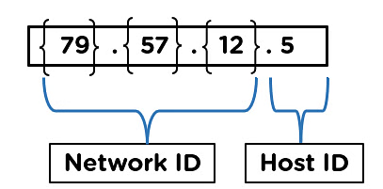
IPv4 and IPv6
There are two versions of IP addresses - IP4 and IP6.
IP addresses in IPv4 are designed to be of 32 bit binary format.
An IPv6 address type is designed of 128 bits from which 4 are hexadecimal digits

Slide 30
IPv4 v IPv6
IPv4 allows for approx 4 billion unique addresses. However, with the growth of the internet and the increase in the number of devices connected to it, the IPv4 space is running out.
IPv6 allows for 1028 times more than IPv4. This means that IPv6 can accommodate a virtually unlimited number of devices on the internet.
In the case of IPv4 addressing no encryption or authentication services are initiated.
IPv6 provides proper encryption and authentication services for the address.
https://www.simplilearn.com/tutorials/cyber-security-tutorial/difference-between-ipv4-and-ipv6

Slide 31
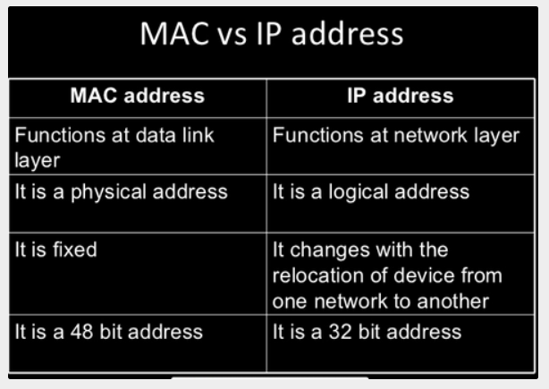
MAC Address
MAC (Media Access Control) addresses are assigned to all devices so that they can be identified on a network. MAC addresses are usually hexadecimal.
Both are used to uniquely define a device.
The manufacturer provides the MAC address.
The Internet Service Provider provides the IP address.
MAC is a physical address of the device.
IP identifies the connection of the network the device
is connected to.

Slide 32
TCP/IP (HL)
TCP and IP are often combined into one family of protocols, TCP/IP.
In summary, TCP keeps track of the packets of information and makes sure that they arrived error free and in the correct order.
IP governs the creation of the packets, and their addressing and routing across the network

Slide 33
Advantages of using layers
It breaks the network communication into manageable pieces. This helps developers concentrate on only one area of the network at a time.
As layers are self contained, they can be changed without other layers being affected.
Having set rules for each layer forces companies to make compatible, universal hardware and software so different brands will work with each other and always work in basically the same way.

Slide 34
WIFI
WiFi is the radio wave technology that allows devices such as phones, TV’s, laptops and printers to communicate with each other and to access the internet wirelessly.
The WiFi protocol operates at the hardware layer. It manages the flow of data around a WiFi network such as the one in your home. It controls the radio signals that transmit the 1’s and 0’s around the network

Slide 35
VOIP
VOIP stands for Voice over Internet Protocol.
VOIP is actually not one single protocol but a number of methods which are designed to deliver voice data (and often associated data, such as video) over the internet.
Facetime, Whatsapp and Skype all use VOIP methods.

Slide 36
Internet hardware components
The Internet is a global network of computers.
We are familiar with desktop and laptops computers, tablets and phones. However, there are other, less well known hardware that connects all of these end user devices together.
These internet hardware components help to move data from place to place and include
Gateways
Routers
Network bridges
Switches
Repeaters
Their functions are summarised on the next slide.
They connect to each other over copper cables or fibre optic cables

Slide 37
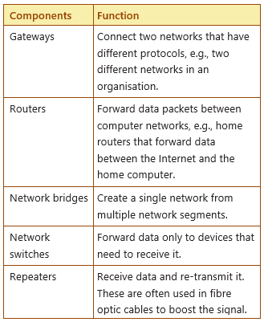
Internet Hardware Components

Slide 38
Cables
Internet hardware is connected via copper or fibre cables.
Fibre optic cables are the better choice due to the following reasons:
Faster Transmission.
Data transmission is measured as Bandwidth.
Copper based transmissions max at about 40Gbps whereas
Fibre can carry data at a much faster rate
Distance
Both Copper and Fibre weaken over distance but Fibre can transmit over much longer distances.
Interference
Electrical signalling in a Copper network can generate interference. This can be a security risk.
Light transmission in Fibre does not generate interference and is therefore more secure.
NOTE: Bandwidth is often mistaken for internet speed when it's actually the volume of information that can be sent over a connection in a measured amount of time – calculated in megabits per second (Mbps).

Slide 39
Cloud computing
Cloud computing refers to storing and accessing data and programs over the internet. The data and programs are stored on servers rather than on your local computer. The term cloud is just a metaphor for a server accessed via the Internet.
These servers are generally managed and hosted by companies called cloud storage providers. The company is responsible for keeping the data available and accessible.
People and organisations can buy or lease cloud storage capacity from providers such as Google Drive, Amazon Cloud and Dropbox. Webmail clients, Google Drive, accounting software and many products that we use every day are based on cloud models.

Slide 40
Cloud computing
The benefits of cloud computing compared to using software on your own machine include the ability to share files easily between many users, remote access to files and always having access to the most up to date software.
Problems include the risk of security breach and the requirement to have an internet connection for access.

Slide 41
How does it all work?

Slide 42
What happens when you search the web?
When you type a web address into your browser:
The browser goes to the DNS (Domain Name Server) server and finds the real address of the server that the website lives on.
The browser sends a HTTP request message to the server, asking it to send a copy of the website to the client. This message and all other data sent between the client and server is sent across your internet connection using TCP/IP.

Slide 43
What happens when you search the web?
3. If the server approves the client’s request, the server sends the client a “200 OK” message, which means “You can look at the website, here it is” and then starts sending the websites files to the browser as a series of small chunks called data packets
4. The browser assembles the small chunks into a complete website and displays it to you.

Slide 44
DNS explained
Real web addresses aren’t the nice, memorable strings you type into your address bar. They are special numbers such as 63.245.215.20
This is called an IP address and it represents a unique location on the web. However it is not easy to remember. That is why Domain Name Servers were invented. These are special servers that match up a web address you type into your browser to the websites IP address.
You can find the IP address of a website by typing its domain into a tool like IP checker.

